Slide 1
Oral Cavity
By
Alia Mohammed Khudier

Slide 2
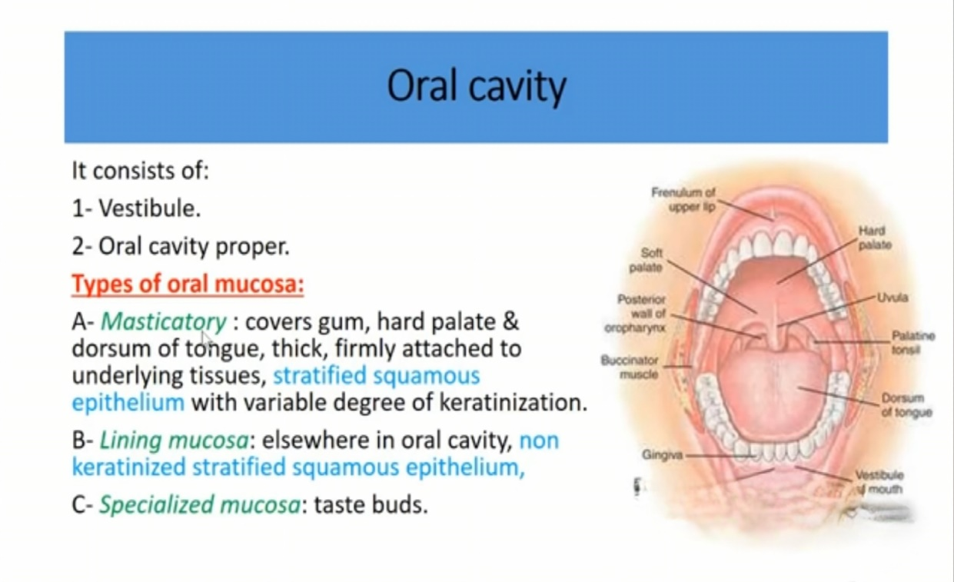

Slide 3
LIPS– labium oris
The Lip has three surfaces:
1- Skin surface: thin skin
keratinized stratified squamous epithelium has sweat glands, and many hair follicles with sebaceous glands
2- Red margin
Transitional zone between the skin and the mucous surface
Rich in sensory nerve ending
Lined by thin keratinized stratified squamous epithelium and rich in blood capillaries
3- The mucous surface
Epithelium non keratinized stratified squamous epi.
Lamina propria contains labial salivary glands

Slide 4
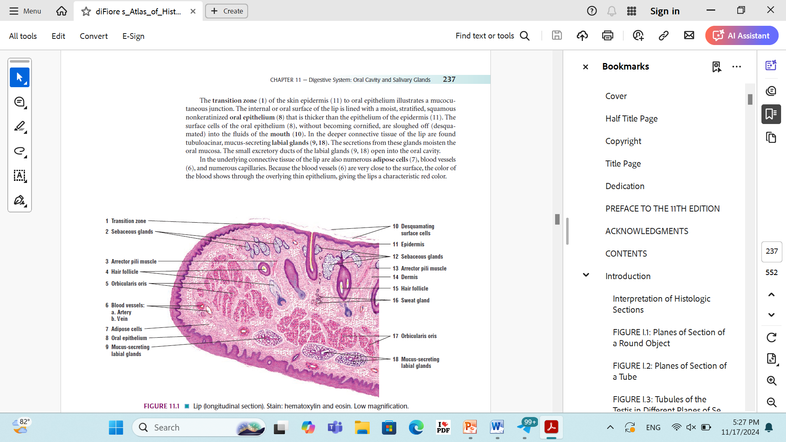
The central core of the lips is made of skeletal muscle – orbicularis oris muscle- surrounded by fibroelastic connective tissue.

Slide 5
TONGUE - lingua
- muscular organ covered externally by mucous membrane - tunica mucosa engages in mastication, swallowing, speech and taste
- Anatomically has 2 surfaces: dorsal and ventral.
The dorsal surface is divided by gustatory line (sulcus terminal ) into anterior 2\3 and posterior 1\3.

Slide 6
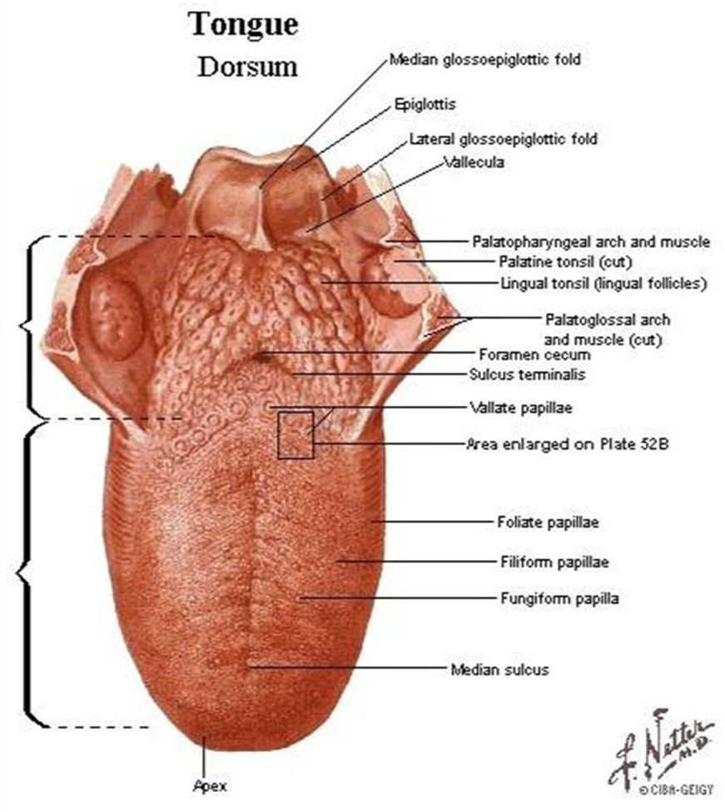

Slide 7
TONGUE
The basis of the tongue consists of striated skeletal muscle, formed by the bundles of muscle fibers oriented in three planes- longitudinal, vertical, and transversal.

Slide 8
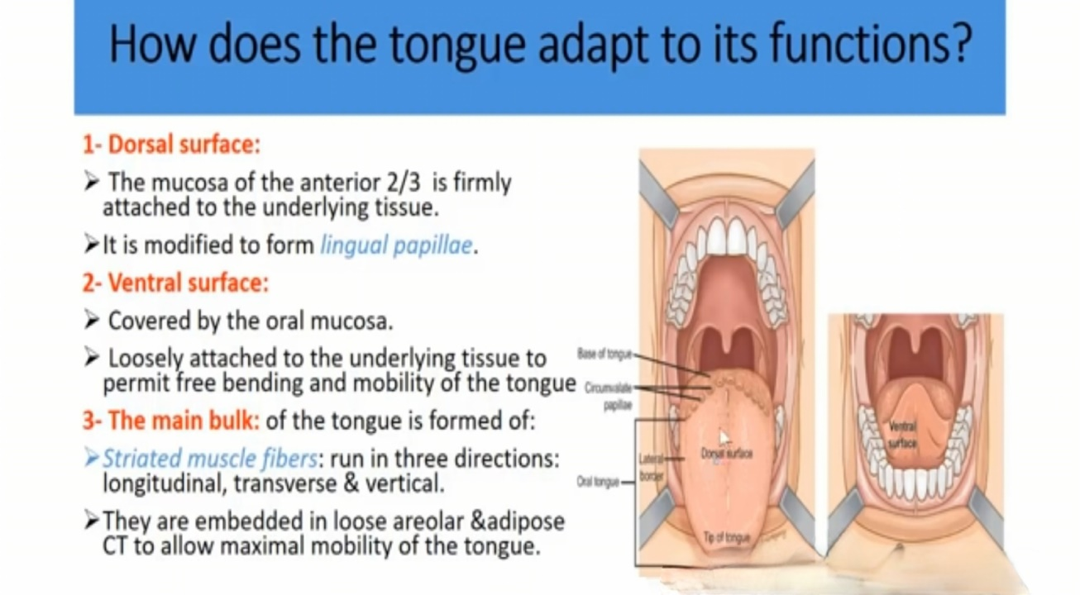
TONGUE
1- Dorsal Surface:
The mucosa of the anterior 2\3 is firmly attached to the underlying tissue.
It is modified to form lingual papillae.
2- Ventral Surface :
Covered by the oral mucosa
Loosely attached to the underlying tissue to permit free bending and mobility of the tongue.
3- The main bulk: of the tongue is formed of
Stratified muscle fibers: run in three directions longtiudinal, transveres and vertical
The muscle embedded of loose areolar and adipose CT. to allow maximal mobility of the tongue.
l

Slide 9
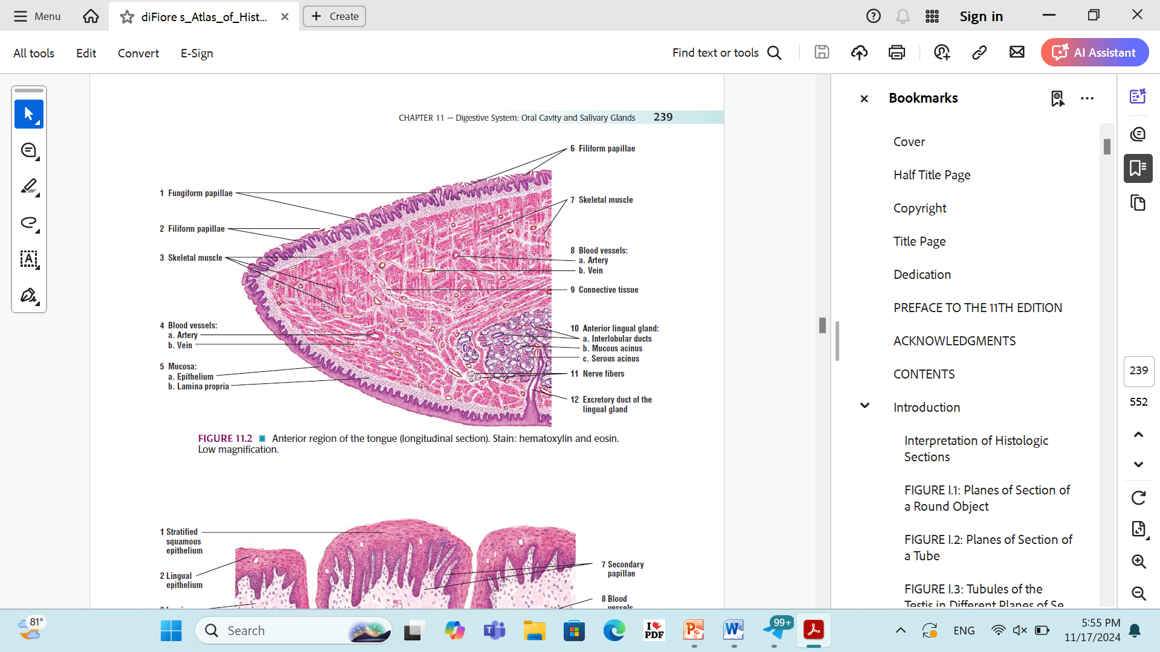
TONGUE

Slide 10
The lingual papillae
Definition: Elevation on the anterior 2\3 of the dorsal surface of the tongue.
Function: Increases the surface area of the mucosa coming in contact with the food.
Structure : Each papilla has a core of connective tissue covered by stratified squamous epithelium (with variable degree of keratinization).
This core may projects to indent the epithelium to form secondary papillae.

Slide 11
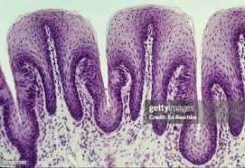
The lingual papillae

Slide 12
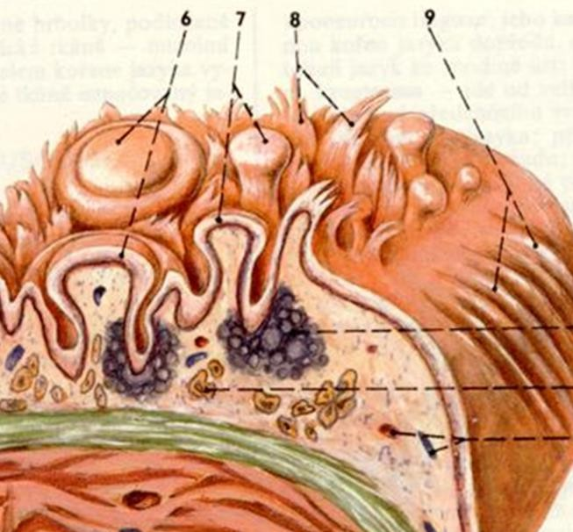
The lingual papillae
The mucosa of the anterior two thirds is formed into papillae of three types:
1- Filiform papillae – 8
  enlarged conical shape
  Epithelium keratinized stratified squamous epithelium
  present over entire surface
  taste buds: absent
  secondary papillae: short or absent

Slide 13
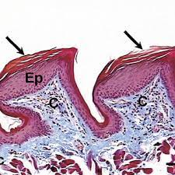
1- Filiform papillae

Slide 14
2- Fungiform papillae
Fungiform papillae - 7
  Number: Few
  Shape: mushrooms -shaped
  Distribution: interspersed among filiform papillae
Especially on the tip and edge of the tongue.
  Taste buds: Few, present in the apical part of the papillae
  Secondary papillae: Short.

Slide 15
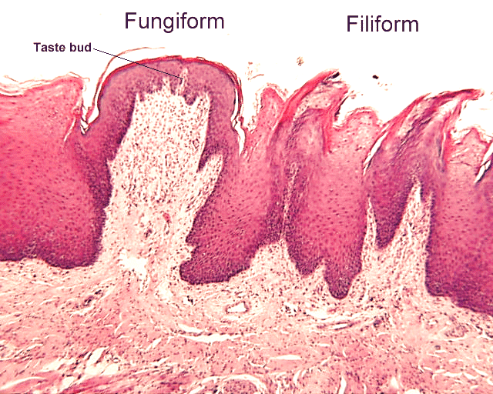
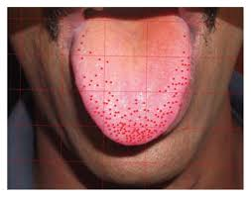
Fungiform papillae

Slide 16
3- Circumvallate papillae
3- Circumvallate papillae – 6
Number: 8-12
Distribution: Just in front of the gustatory line.
Shape: Largest, seen by the naked eye
Triangular in shape
* Each papilla is surrounded by a trench where ducts of Von Eibner’s gland open into bottom.
Taste buds: Numerous, present along the sides of the papillae.
Secondary papillae: Short

Slide 17
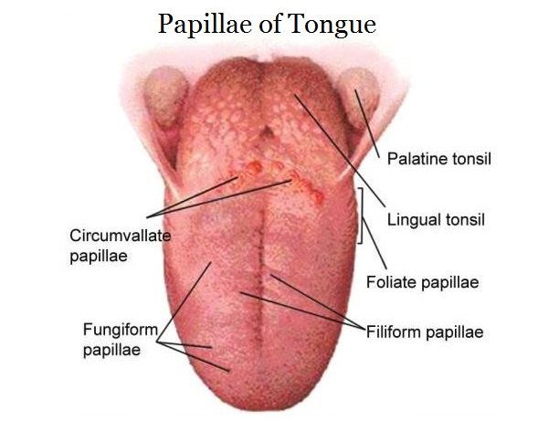
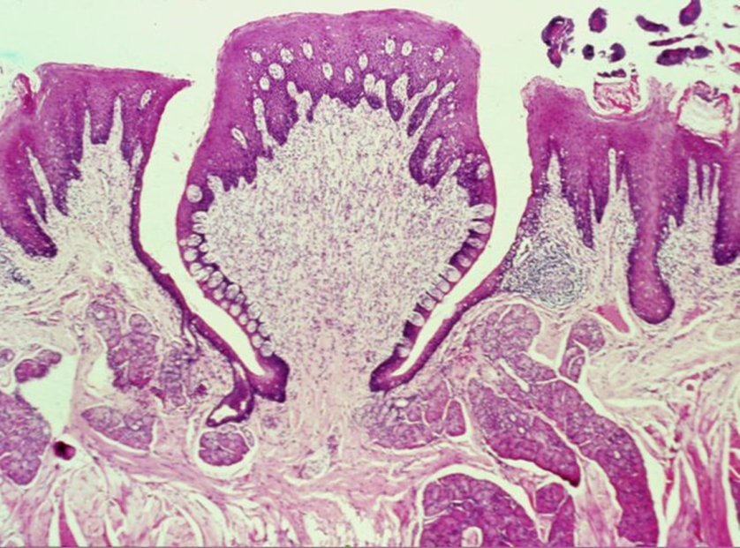
Circumvallate papillae-6

Slide 18
Von Eibner’s glands
Definition: Serous lingual glands
Site: In the connective tissue encircling each circumvallate papillae.
Function:
Their secretion dissolves the food particles to facilitate perception of taste.
2. The flow of secretion washes away food particles around the taste buds so, they can receive new taste
Stimulus.
3. The secretion contain lipase enzyme which prevents
formation of hydrophobic layer.

Slide 19
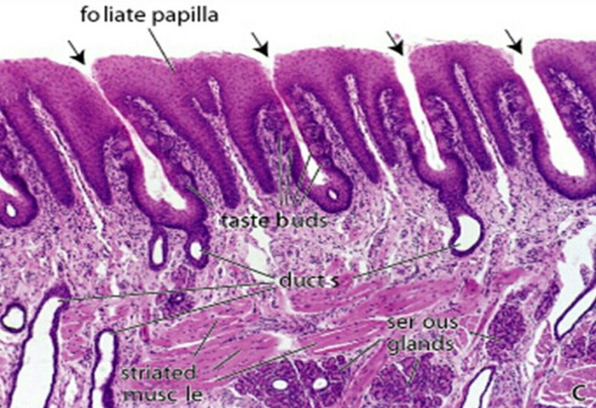
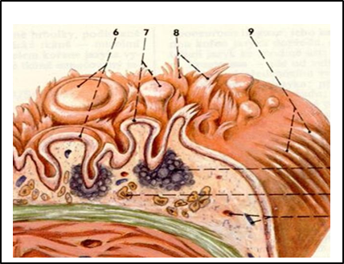
4. Foliate papillae
Foliate papillae – 9
  poorly developed in human found in rabbit.
  present on lateral tongue borders.
  Shape: rectangular.
  Secondary papillae: long
Taste buds: Numerous, present along sides of the papillae.

Slide 20
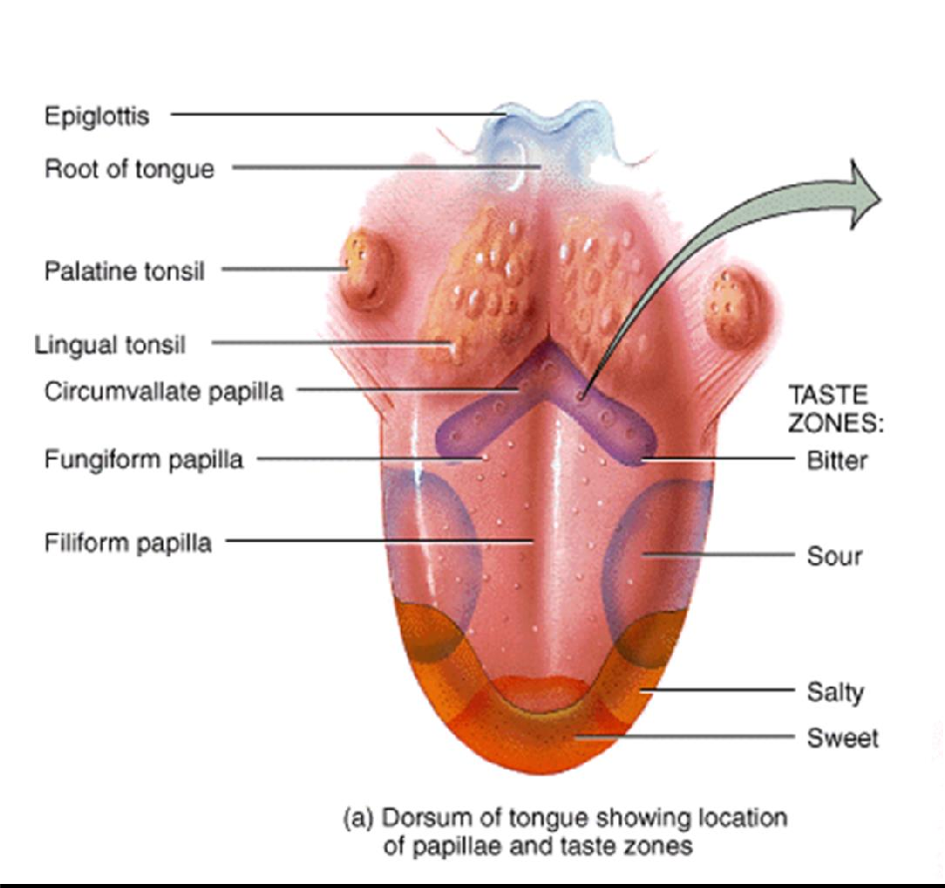

Slide 21
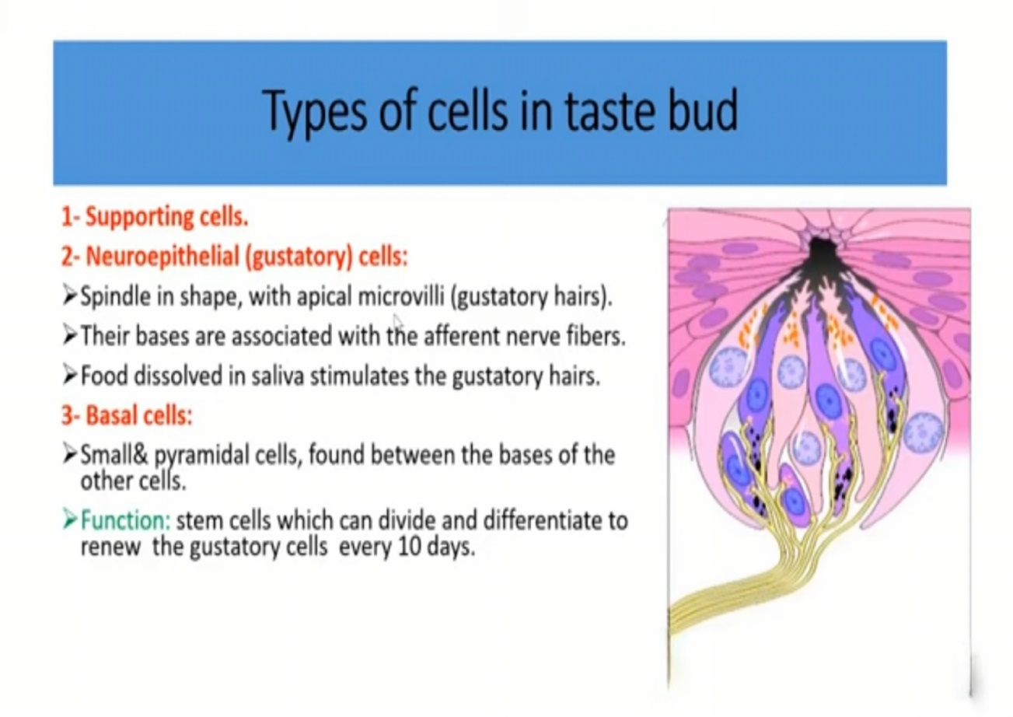

Slide 22
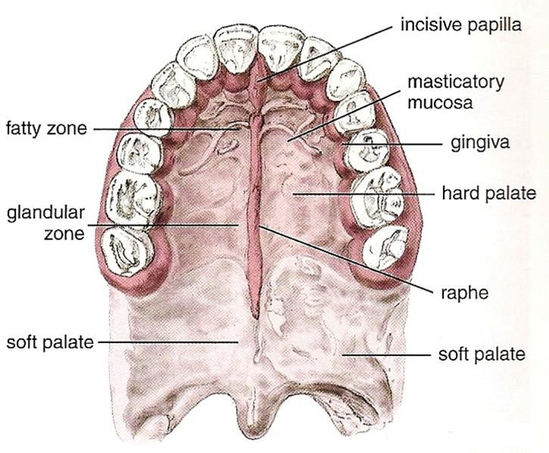
PALATE – palatum
The palate forms the roof of the mouth and separates into oral and nasal cavities.
The anterior part is the hard palate
the posterior is soft palate.
The hard palate is rigid made of horizontal bony.
Covered by masticatory mucosa that serves as a working surface for the tongue during mastication and swallowing.
The mucosa adheres firmly to the periosteum of bone.
Its keratinized or stratified squamous epithelium has underlying
connective tissue papillae.

Slide 23
lamina propria: Contain many capillaries and infiltrated lymphocytes.
Submucosa: Very posterior part to the epithelial surface has small mucus-secreting palatine glands.

Slide 24
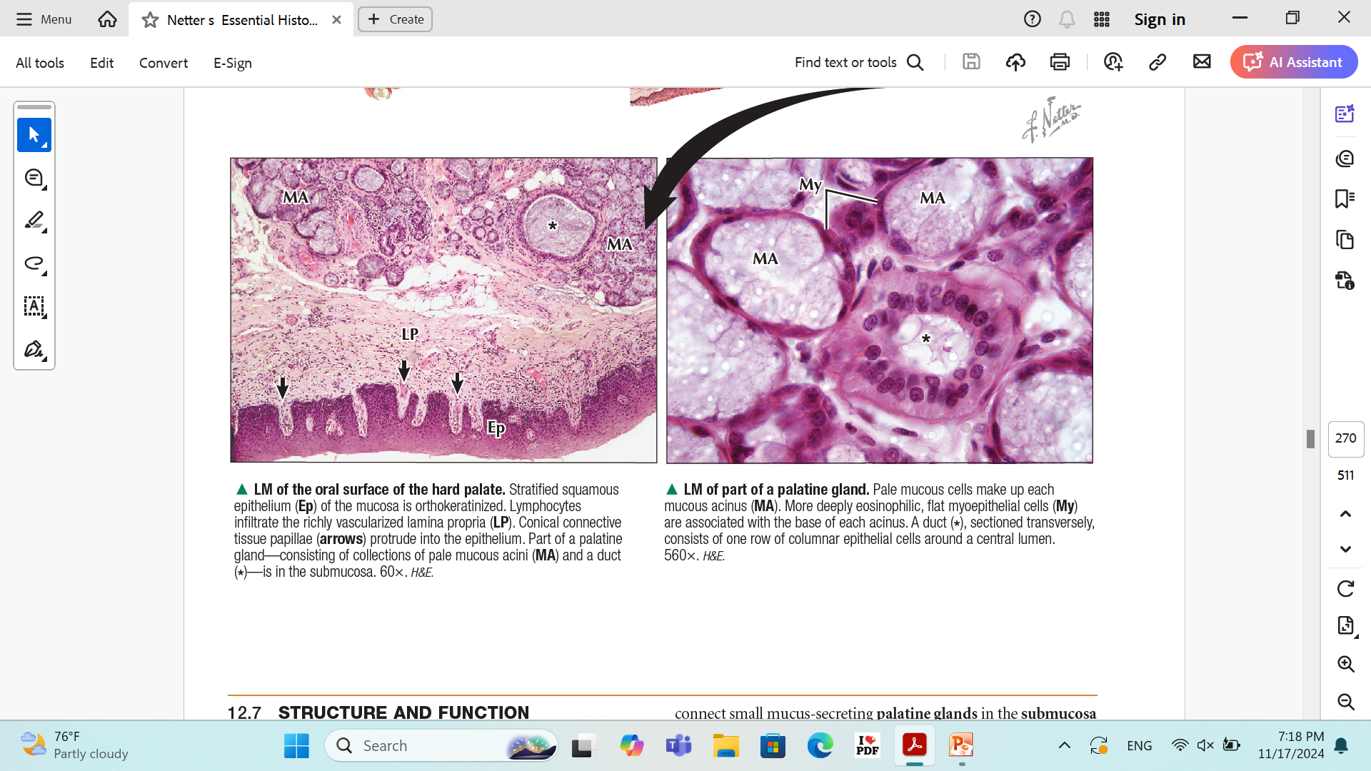
LM of the oral surface of the hard palate. Stratified squamous epithelium (Ep). Lymphocytes infiltrate the richly vascularized lamina propria (LP). Conical connective tissue papillae (arrows) protrude into the epithelium. Part of a palatine gland—consisting of collections of pale mucous acini (MA) and a duct (*)—is in the submucosa.
LM of part of a palatine gland. Pale mucous cells make up each
mucous acinus (MA). More deeply eosinophilic, flat myoepithelial cells (My)
are associated with the base of each acinus. A duct (*), sectioned transversely,
consists of one row of columnar epithelial cells around a central lumen.

Slide 25
2- soft palate
The soft palate a mobile fold with a conical posterior projection called the uvula—closes off the nasopharynx.
On the oral side, the epithelium is nonkeratinized stratified squamous.
The nasopharyngeal side has a respiratory epithelium-ciliated pseudostratified columnar epithelium with goblet cells

Slide 26
2- soft palate
lacks bone, but its core contains a support sheet of palatine skeletal muscle.
Submucosal contain mucous glands are near the oral surface and mixed seromucous glands, the nasopharyngeal side.

Slide 27
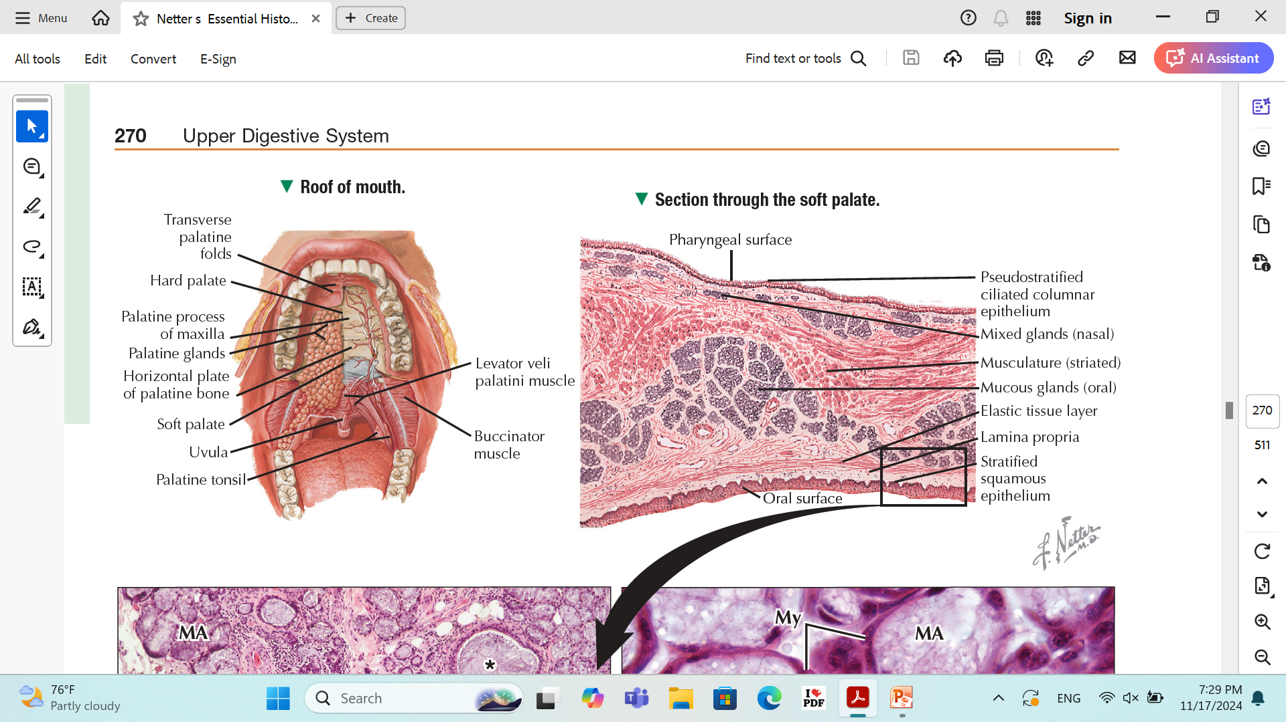

Slide 28
HISTOLOGY OF THE
CHEEK AND GINGIVA
The cheek resembles the lip in histologic features.
- Epithelium: Stratified squamous non-keratinized.
- Lamina propria, has short papillae and abundant of elastic fibers, attaches to underlying skeletal muscle fibers.
These fibers are arranged into fascicles that mix with minor salivary (buccal) glands.

Slide 29
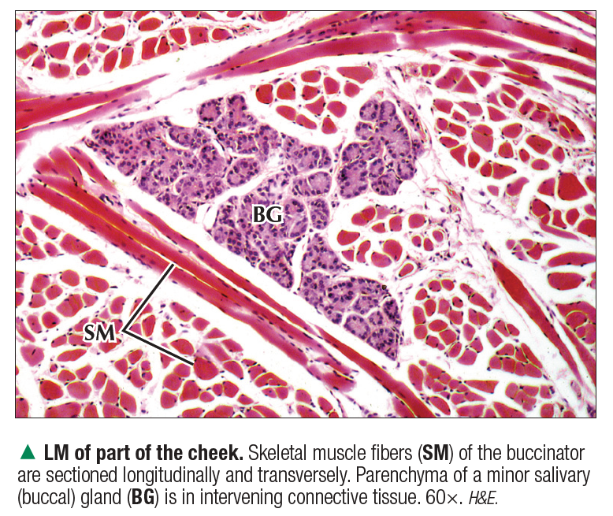
HISTOLOGY OF THE
CHEEK

Slide 30
HISTOLOGY OF THE
GINGIVA
The gingiva, a mucous membrane that lacks glands, covers outer and inner surfaces of the alveolar processes of the maxilla and mandible and surrounds each tooth.
Epithelium is lightly keratinized stratified squamous Ep.
Lamina propria is richly vascularized

Slide 31
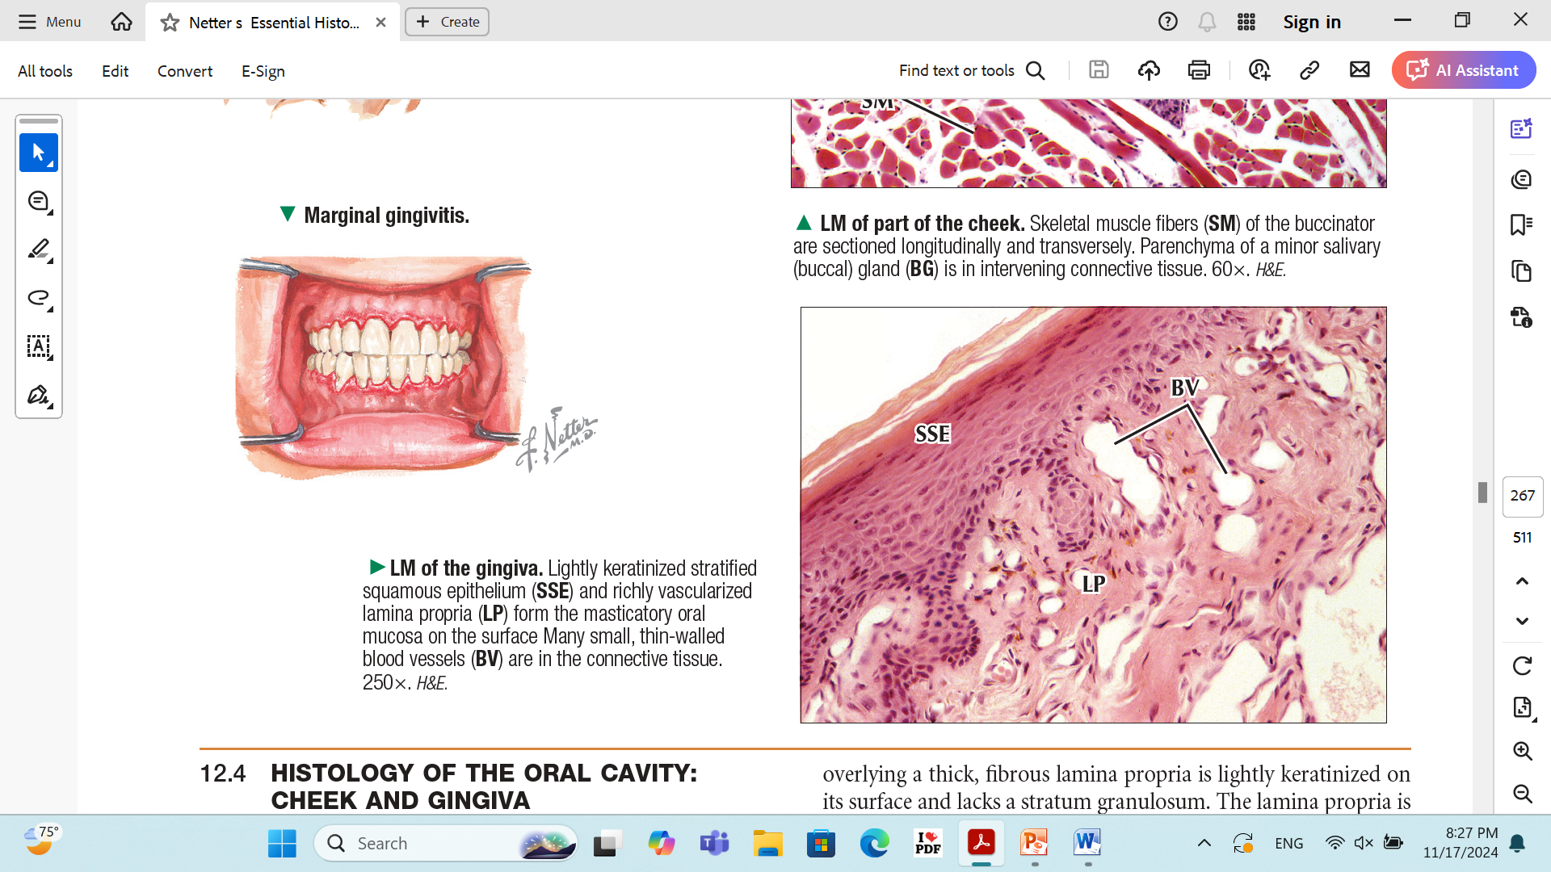

Slide 32
STRUCTURE AND FUNCTION OF TEETH
Humans have two sets of teeth. The primary (or deciduous) teeth (20 teeth by about 2 years) and permanent teeth (32 teeth: between 6-12 years).
Each tooth consists of a free crown projecting above the gingiva, and one or more roots embedded in a bony socket (jawbone).
Enamel- acellular, brittle material composed of calcium salts and hydroxyapatite crystals

Slide 33
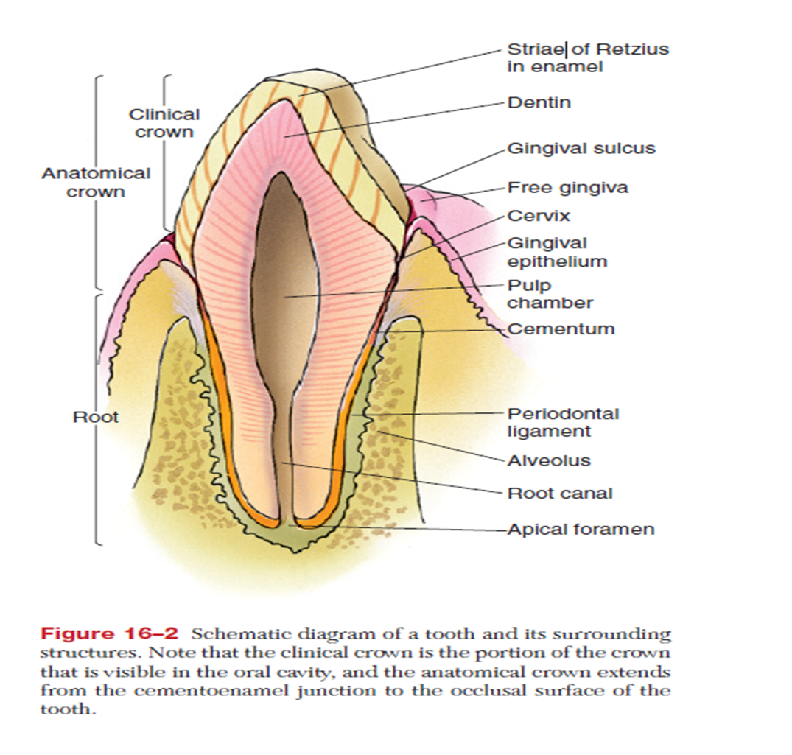
The portion between the crown and the root is the cervix.
Cementum: calcified Connective tissue
Covers the root
Attaches it to the periodontal ligament
Dentin: bone like material deep into enamel cap
Pulp cavity surrounded by dentin
Root canal
Apical formen

Slide 34
Cells of dentin
1- ameloblasts
2- odontoblasts: Secret and maintain dentin
3- dentain

Slide 35
Each tooth is suspended in its bony socket, the alveolus, by a dense, irregular collagenous connective tissue, the periodontal ligament (PDL).
The gingiva also supports the tooth, and its epithelium seals the oral cavity from the sub epithelial connective tissue spaces

Slide 36
Salivary Glands
Exocrine glands in the mouth produce saliva.
Function: Digestive, lubricating, and protective With a normal pH of 6.5-6.9.
There are two types of salivary glands
1- Major salivary glands
2- Minor salivary glands

Slide 37
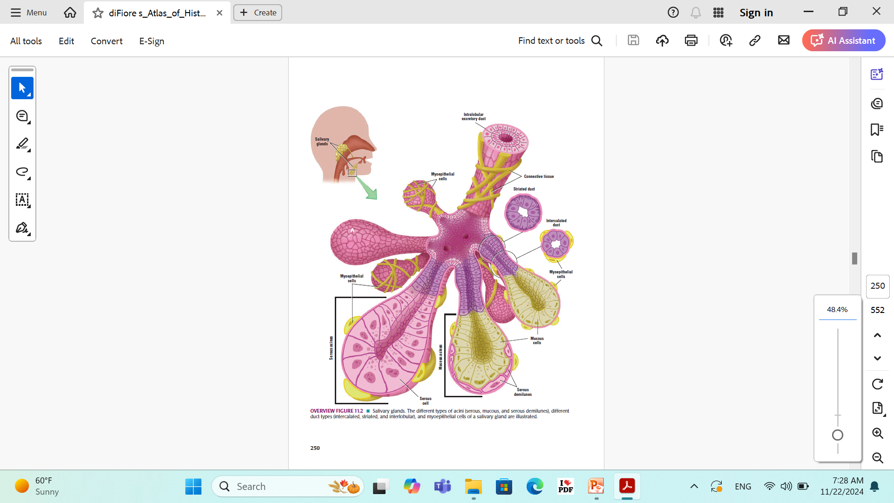

Slide 38
The Minor Salivary glands
Site: Located throughout most of the oral mucosa which secrete about 10% of the total saliva volume.
Ex: The buccal, labial, lingual and palatine glands.
Structure: Simple branched tubuloalveolar glands

Slide 39
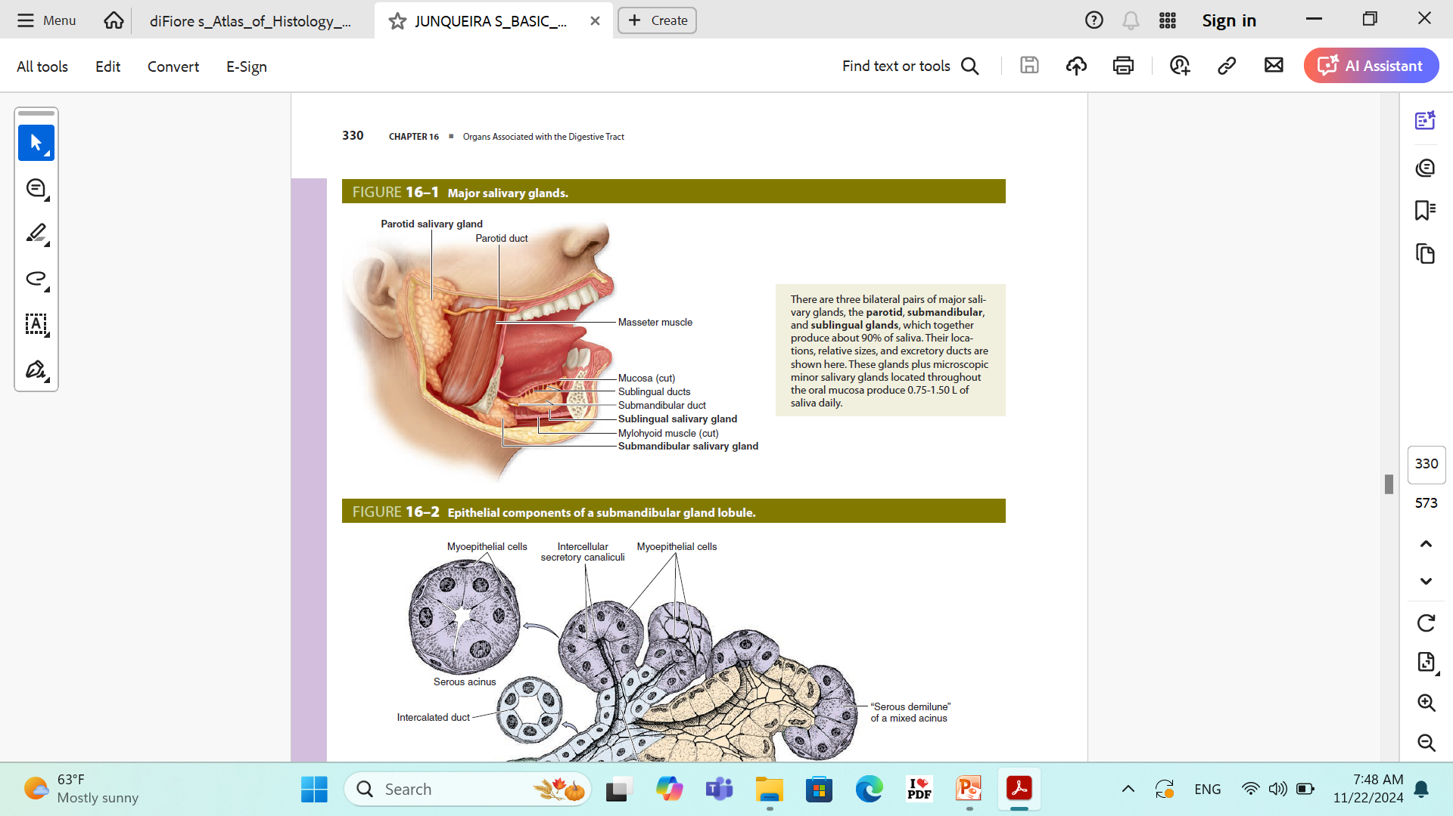
Large salivary glands (Major)
There are three pairs of large salivary glands:
1- parotid,
2- submandibular
3- sublingual glands.
Their secretion is regulated by nervous reflexes.

Slide 40
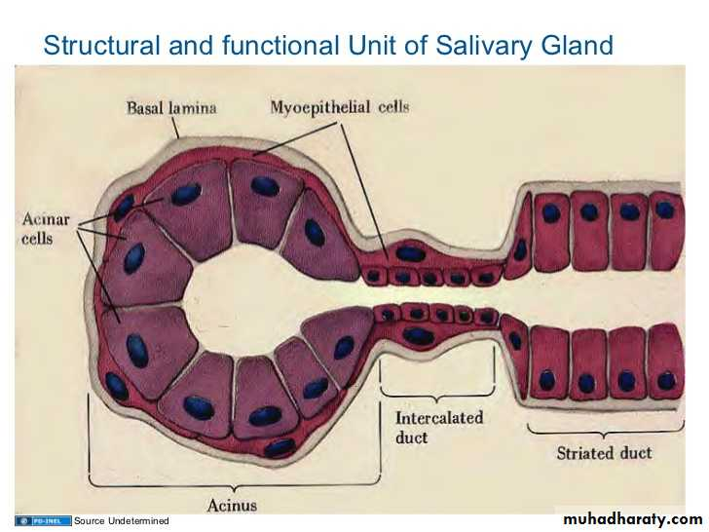
Structure of the major salivary glands
1- Stroma:
CT capsule.
CT septa: That divided the gland
into lobes and lobules
Reticular fibers
2- Parenchyma
Secretory acini: 3 types: serous, mucous and Mixed acini
Duct system

Slide 41
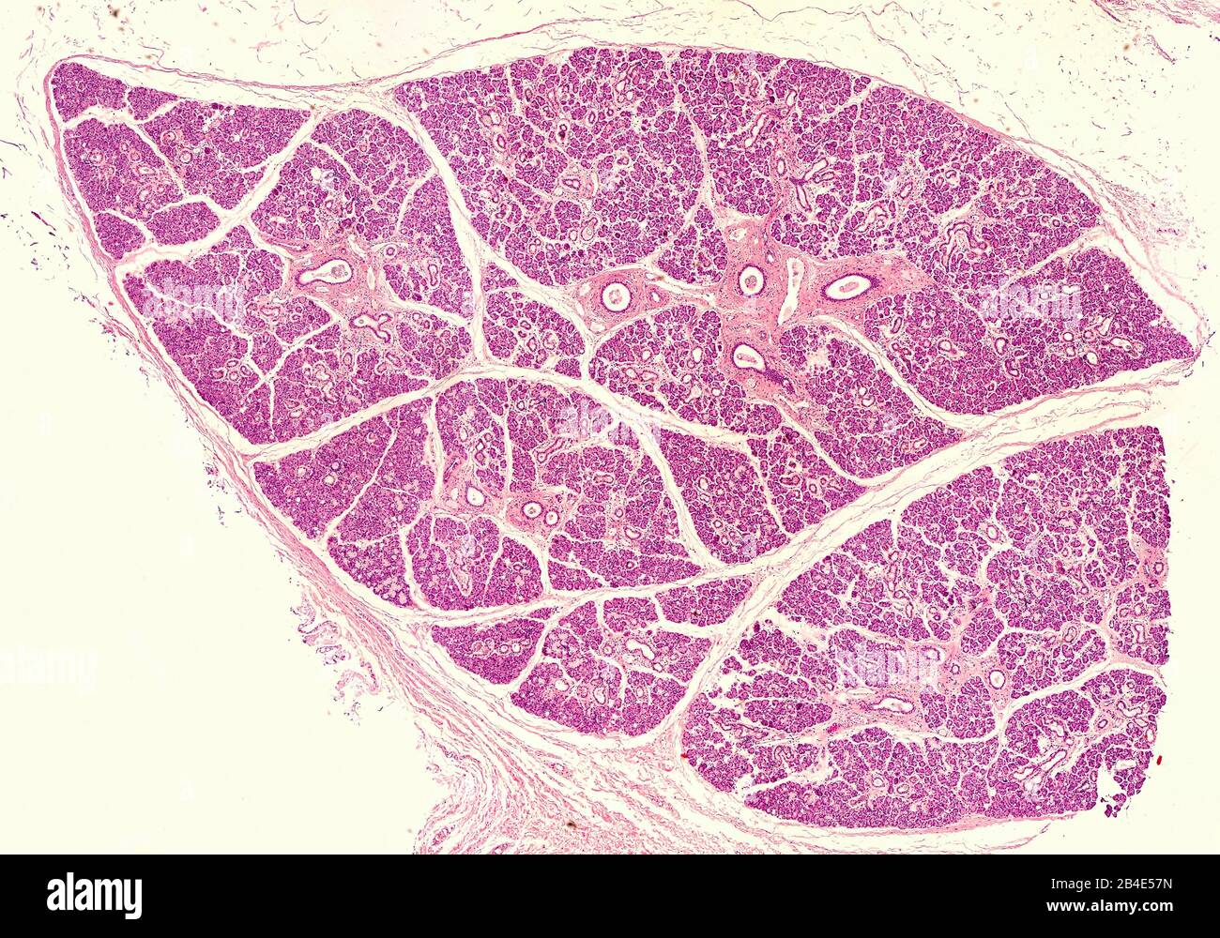
Histological Structure of salivary gland

Slide 42
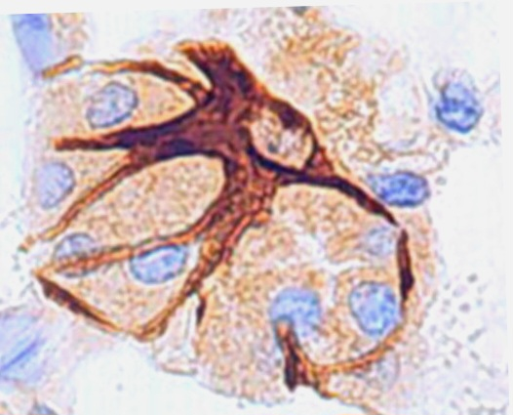
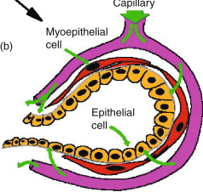
Myoepithelial Cells= Basket cells
Shape: Stellate cells with many processes containing actin and myosin.
Site: Around the acini
especially mucous one &
along the proximal portions of the ducts.

Slide 43
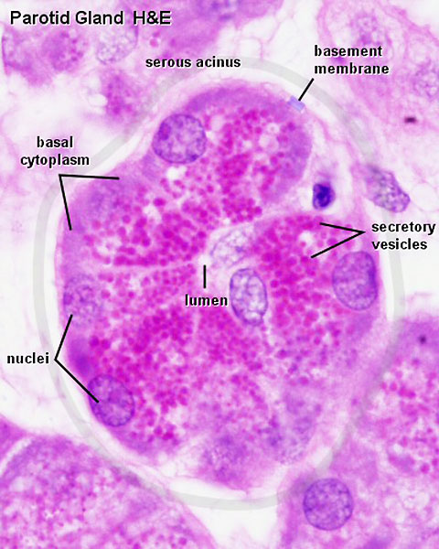
Cells of the Salivary Gland Acini
1- Serous cells
Shape: pyramidal, small, narrow lumen and darkly stained.
Nucleus: spherical or round nuclei situated nearer to the base .
Cytoplasm: basal basophilic (rich in rER) with apical acidophilic secretory granules (zymogen granules) and has Golgi apparatus
Myoepithelial cells: Few surround the acini.
Secretion: Watery, rich in salts and
Digestive enzymes.
Sites: in the parotid, submandibular and the
Von Ebner’s glands

Slide 44
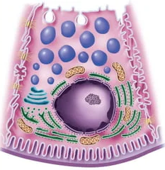
Serous cells

Slide 45
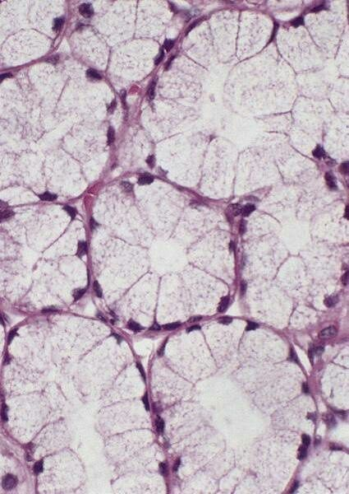
3- Mucous acini
Structure:
Shape: Large, pale, oval with wide lumen.
Lining cells: Cuboidal
Nuclei: Flattened & basal.
Cytoplasm: Pale vacuolated (contents of the granules dissolve during preparation of the H&E).
Myoepithelial cells: numerous surround the acini (as the secretion is thick).
Secretion: Mucus to lubricate the food.
Sites: In the sublingual, submandibular, buccal, labial and palatine glands.

Slide 46
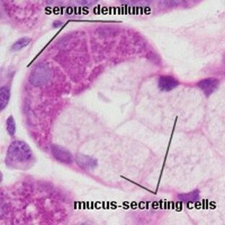
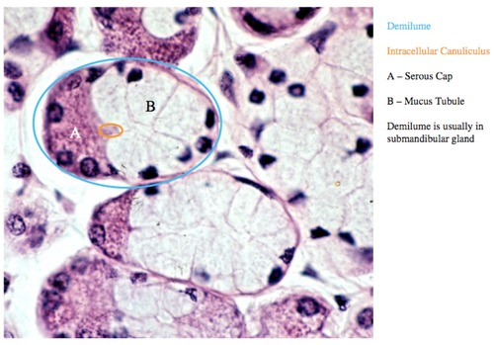
4- Mixed acini
Sites: In the submandibular and few in the sublingual glands.
Shape: mucous acinus with a cap of serous cells (Serous Demilune)
Structure: Each acinus is formed of mucous cells with some serous cells interspersed between them. Both cells pour their secretion into the lumen of the acinus.

Slide 47
Duct System
1- The intralocular ducts: consists of 2 parts
The intercalated ducts: lined by cuboidal cells
The secretory stratified ducts:
Shape: They have a wide lumen
Lining cells: Cuboidal
Nucleus: Central & rounded
Cytoplasm: Acidophilic with basal striation (numerous longitudinally oriented mitochondria)
With basal infoldings
Function: They modified the composition of saliva by active ion pump making the saliva hypotonic solution.

Slide 48
2- The interlobular ducts: They lined by columnar Ep.
3- The interlobar ducts: They are lined by Pseudostratified columnar Ep.
4- The main duct: It is lined at its beginning by stratified columnar epithelium then it becomes non-keratinzed stratified squamous epithelium as it opens into the oral cavity.

Slide 49
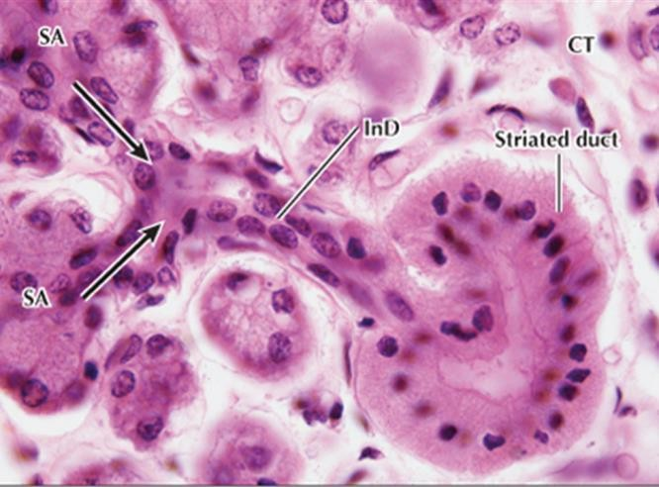
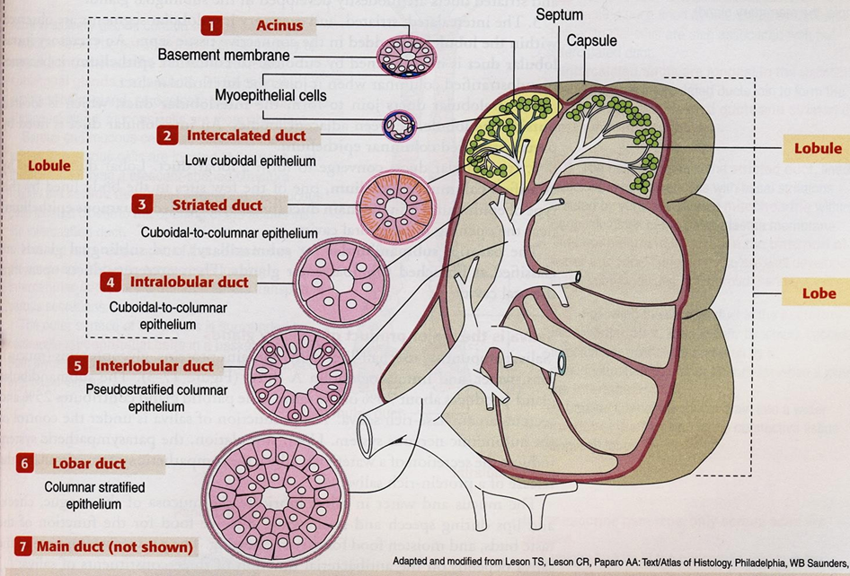
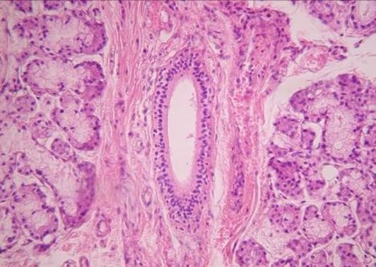
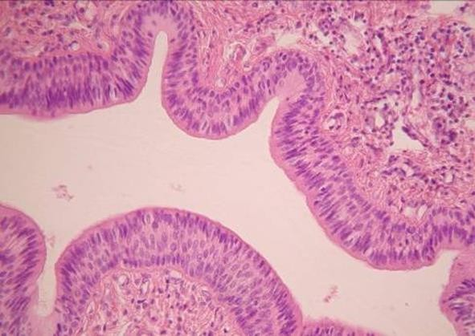
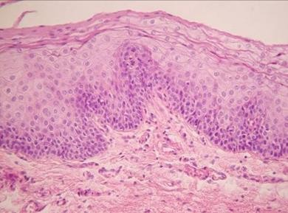

Slide 50
The Parotid gland
Capsule & septa: thick
Fat cells: Large number
Secretory acini: 100% serous acini.
Myoepithelial cells: Few
The intralobular ducts: long, secretory striated ducts form 50% of the length of the intralobular duct.

Slide 51
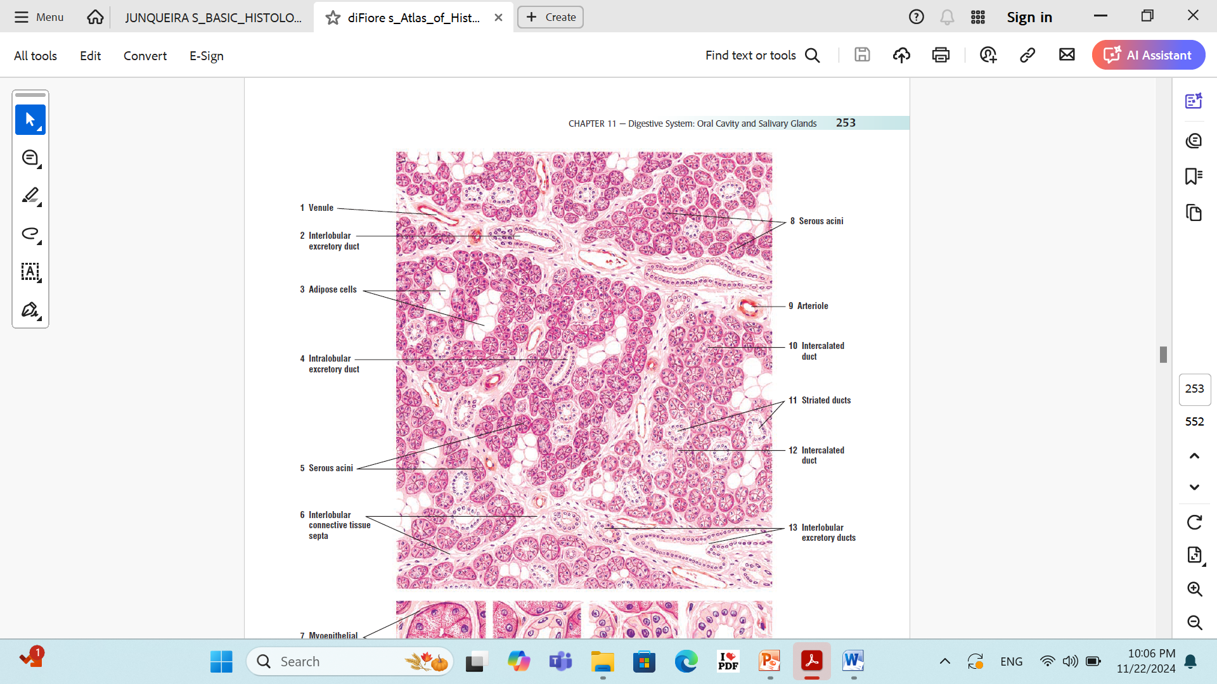
The Parotid gland

Slide 52
The submandibular gland
Capsule & septa: Moderately thick
Fat cells: Absent
Secretory acini: 80% serous acini, 20% mucous acini.
Myoepithelial cells: Frequent
The intralobular ducts: Moderately long, secretory striated ducts form 80% of the length of the intralobular duct.

Slide 53
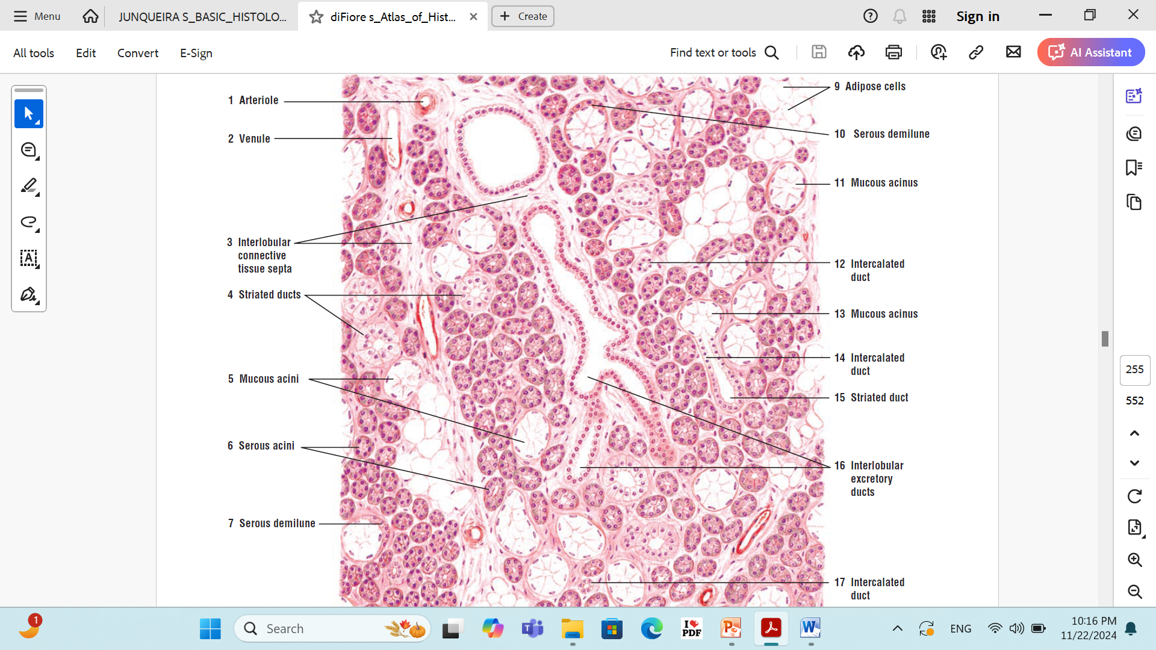
The submandibular gland

Slide 54
The Sublingual gland
Capsule & septa: Thin capsule, thick septa.
Fat cells: absent
Secretory acini: 99% mucous acini, 1% serous acini, represented by the serous Demilune.
Myoepithelial cells: Numerous.
The intralobular ducts: Very short, secretory striated ducts form 99% of the length of the intralobular duct.

Slide 55
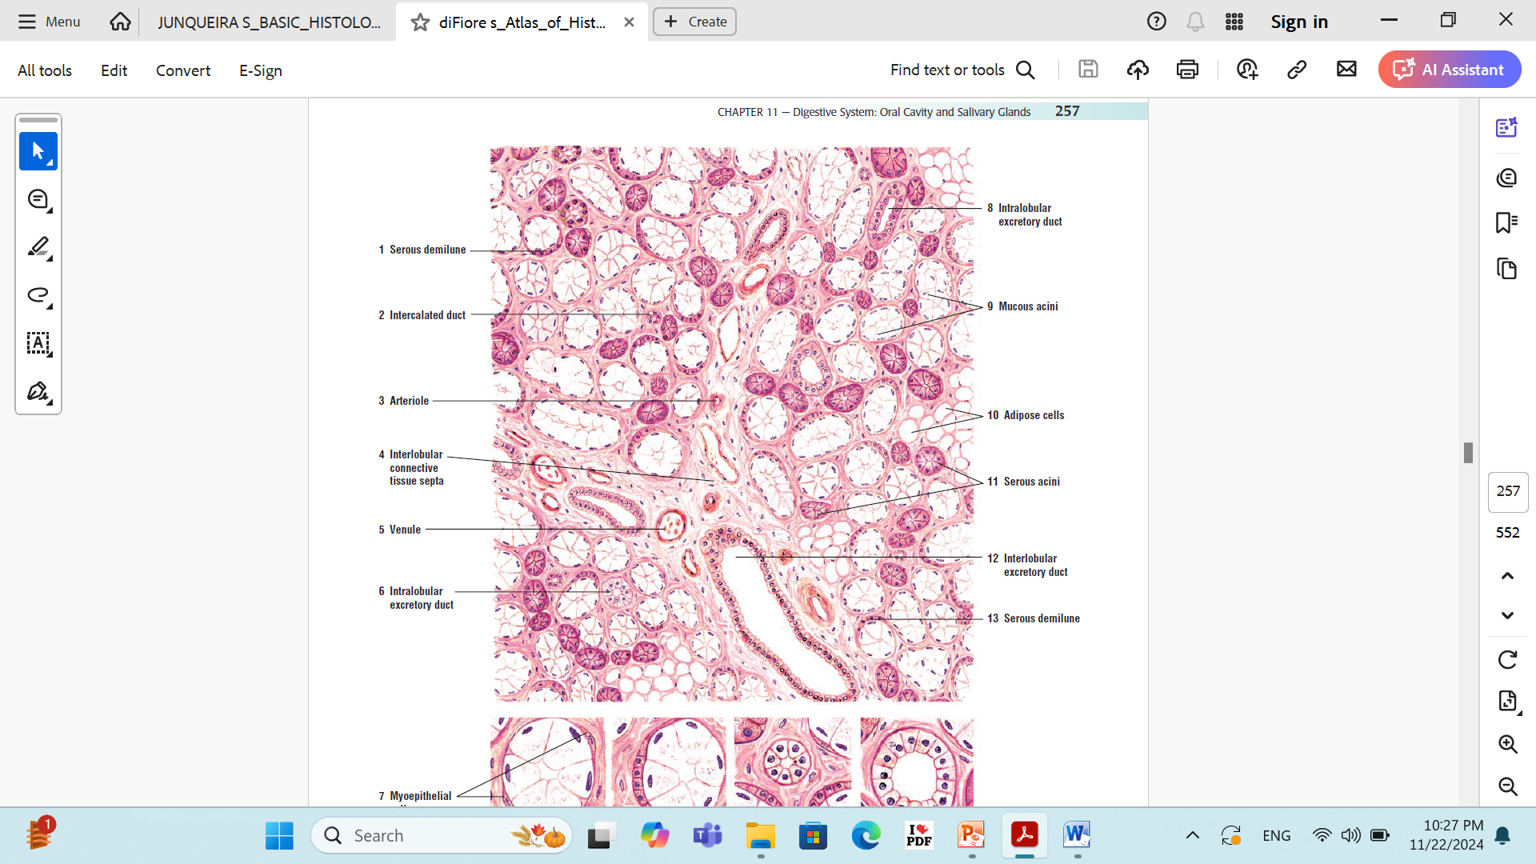
The Sublingual gland

